Slide 1
Making learning visible
Panel 1

Slide 2
The 2012 Recommendation
What is validation?
“a process of confirmation by an authorised body that an individual has acquired learning outcomes measured against a relevant standard”
No focus on where or how
How can systems be developed?
The four stages
The ten principles
To get validation, and/or to obtain a full or part qualification

Slide 3
The four stages
→ Flexible →Learner-centred and learner-driven

Slide 4
The principles
Links with NQFs
Provision of information, guidance and counselling
Targeting disadvantaged groups
Compliance with agreed standards – «either the same as, or equivalent to, the standards for qualifications obtained through formal education programmes”

Slide 5
Channels of influence
Recommendation:
All relevant stakeholders should be involved in the development and implementation of validation arangements.
+ Local participation!

Slide 6
The European Inventory
Monitoring progress and providing an overview of validation across Europe
2016 update
Looking at three broad sectors
Validation arrangements are in place in at least one sector in almost all European countries

Slide 7
Source: The 2016 European Inventory

Slide 8
Users and potential users (3rd sector)
Main users: Young people and volunteers
Recommendation: Disadvantaged groups
European Inventory: Challenge – for social inclusion
NQF as «connector»

Slide 9
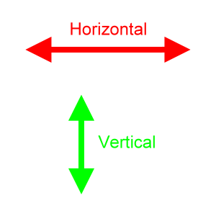
Lisbon conclusions
Collective efforts → more coherent processes
Links to NQFs
More involvement; clear roles
Up-to-date and flexible mechanisms
Common/coherent strategies, guidelines, tools, vocabulary, methods
Focus on employability
Validation for LIFELONG LEARNING

Slide 10
Contact
Hanne Christensen
Senior Adviser
Skills Norway
hanne.christensen@kompetansenorge.no
Skills Norway website

