Slide 1
Volontärbyrån helps people and non-profits
find each other.
Volunteering in Europe: more than a challenge!
Vienna, 5th October 2017
Anna Snell, Volontärbyrån/National Forum for Voluntary Organisations

Slide 2
Volontärbyrån
Funded in 2002
On-line tool to help CSOs (civil society organisations) find volunteers
3000 registered CSOs
700 active volunteer assignments
8000 volunteers each year
Capacity building in volunteer management for CSOs
Run by the National Forum for Voluntary Organisations

Slide 3
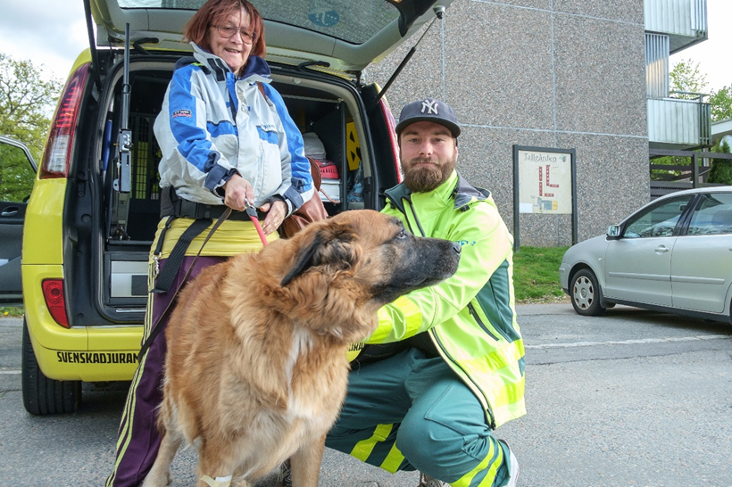
Volunteering in Sweden
53% of Swedes volunteer
Average 15 hours a month
CSOs within sports and social sphere dominate
53% men, 47% women volunteer
Tradition and history of volunteering
More than 200 000 CSOs in Sweden, 9 out 10 Swedes are members

Slide 4
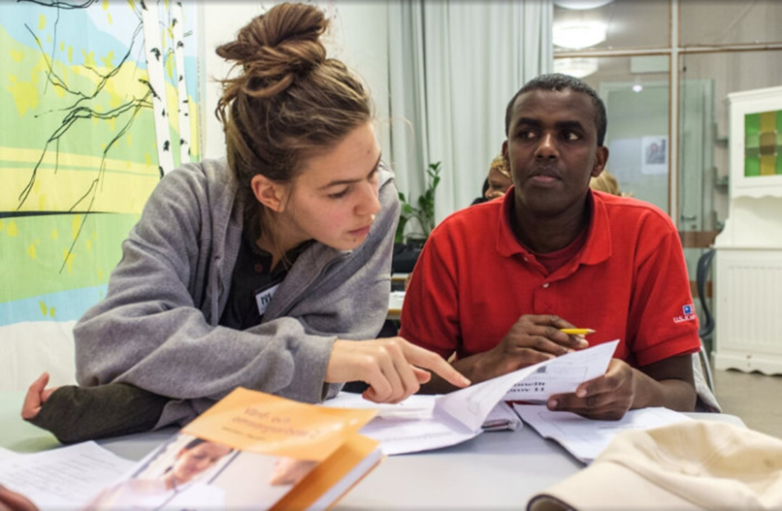
Motivational factors
Being part of something positive
Do something concrete
Feel needed
Helping others

Slide 5
The value of volunteering
Individual
Health
Feeling needed
Wider social network
Being a part of society – and influencing it
Organisation
Developing/changing something together
Providing a platform for people to engage
People meeting volunteers
Society
Develops trust
Develops welfare
Promotes democracy
Positive for public health

Slide 6
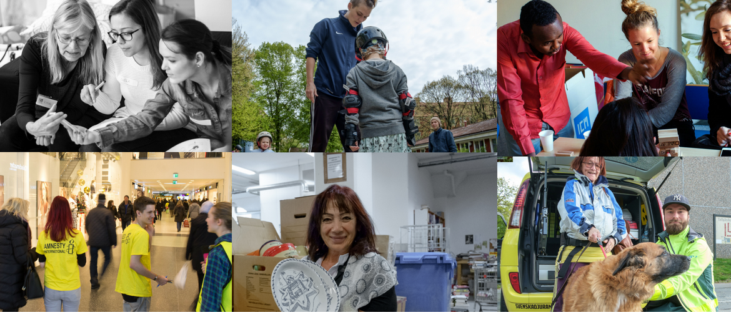
Promoting volunteering
Who organises volunteers is important
Consider motivational factors of volunteers
Make it easy, provide structure and describe the bigger picture
Keep volunteering voluntary

